Slide 1
Lecture 37 – Dijkstra’s Algorithm
CST370 – Design & Analysis of Algorithms
Dr. Byun
Computer Science

Slide 2
Lecture Objectives
After completion of this lecture, you will be able to
  apply a greedy technique to solve the single source shortest paths problem using the Dijkstra’s algorithm.

Slide 3
Chapter 9: Greedy Technique
9.1 Prim’s Algorithm
9.2 Kruskal’s Algorithm
9.3 Dijkstra’s Algorithm
9.4 Huffman Trees and Codes

Slide 4
Dijkstra’s Algorithm
Single-source shortest path problem.
  Dijkstra’s algorithm finds the shortest path from a source vertex s to all other vertices.

Slide 5
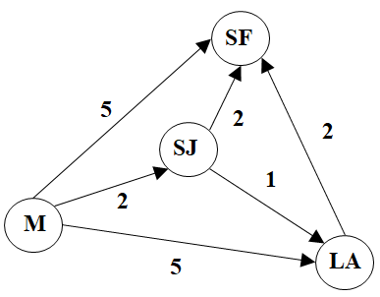
Example

Slide 6
Dijkstra’s Algorithm – Basic Idea
Among vertices not already visited, find a vertex u with the smallest sum of
d_{v} + w(v, u)
where
v: vertex already visited
d_{v}: length from s to v
w(v, u): length from v to u

Slide 7
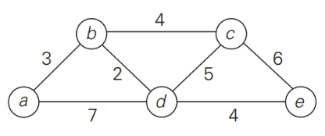
Example
Vertex Visited
Remaining Vertices

Slide 8
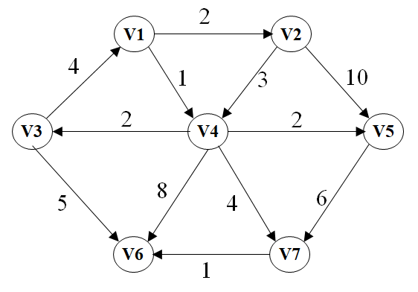
Exercise (1 of 2)

Slide 9
Exercise (2 of 2) – Present only first three rows.
Vertex Visited
Remaining Vertices

Slide 10
Puzzle

